Slide 1
Introduction to .NET Compiler Platform “Roslyn”
Mark Zhou

Slide 2
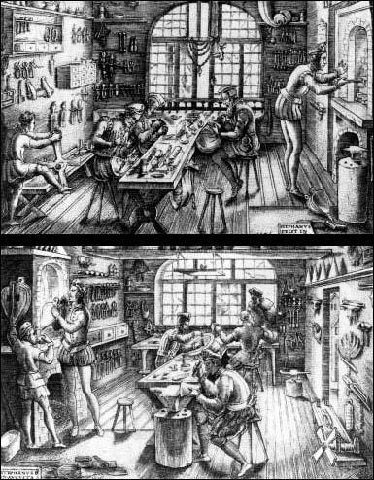

Slide 3
What is the .NET Compiler Platform (“Roslyn”)?
An open-source project, where we’re developing:
The APIs VS uses to analyze your C# and VB source code
New C# and VB managed compilers built on these APIs
Compiler extensibility for custom warnings and errors
VS extensibility for code fixes and refactorings
APIs for hosting C# and VB in your apps as scripting languages

Slide 4
The Big Switch
ISO-1
ISO-2
C# 3
C# 4
C# 5
C# 6
C# 7
C# 7.1
C# 7.2
C# 7.3
C# 8.0
C# Next
C# is written in native
C# is written in C#

Slide 5
Where We’re At Today
Shipped Roslyn 3.3.1 in Visual Studio 2019 16.3
C# 8 and Visual Basic 16
New C# and Visual Basic compilers
Public code analysis APIs (i.e. .NET Compiler Platform)
New C# and Visual Basic language services for Visual Studio
Code Aware Libraries
Open Source
http://github.com/dotnet/roslyn or http://roslyn.io
Opened source for the C# and VB language services for Visual Studio
Opened source for the C# and VB Scripting and Interactive Windows

Slide 6
.NET Compiler Platform Architecture

Slide 7
Formatter
Colorizer
Outlining
Navigate To
Object Browser
Completion List
Find All References
Rename
Quick Info
Signature Help
Extract Method
Go To Definition
Edit and Continue
Language Service
Compiler API
Parser
Symbols
Binder
Emit API
Syntax Tree API
Symbol API Operation API
Binding and Flow Analysis APIs
IL Emitter
Compiler Pipeline
Metadata Import
Notes:
Current setup

Slide 8
API Layers and Extensibility
Extensibility
Refactorings
Code Fixes
…
Code Formatting
Find All References
Expand/Reduce
…
Workspaces APIs
Workspaces (Solutions/Projects/Documents)
Extensibility
Diagnostics (custom warnings and errors)
…
Syntax Trees
Symbols
Operations
Binding and Flow Analysis
Emit
Compiler APIs
Notes:
New setup.

Slide 9
Workspace API
Host Environment
Events (e.g. key presses)
Workspace
Apply
Solution
Edit
Solution²
Edit
Solution^{n}
Compilation
Project
Project
Document
Document
SyntaxTree

Slide 10
Syntax Tree API – “Trivia”
class∙C↵
{↵
∙∙∙∙void∙M()↵
∙∙∙∙{↵
∙∙∙∙}↵
}// C↵
▫
CompilationUnit
ClassDeclaration
EOF
class
SP
C
EOL
{
EOL
MethodDeclaration
}
// C
EOL
SPx4
void
SP
M
ParameterList
Block
(
)
EOL
SPx4
{
EOL
SPx4
}
EOL

Slide 11
Compilations
Syntax Trees
Compilation
References
Symbols
Emit
Diagnostics
Flow Analysis
Semantic Model

Slide 12
Demo
Syntax Tree Visualizers SharpLab.io
Notes:
Follow the steps on this guide for the syntax visualizer
https://blogs.msdn.microsoft.com/visualstudio/2011/10/19/roslyn-syntax-visualizers/
Ensure you have the .NET Compiler Platform SDK extension installed.
Show Global class in the ScriptingWithRoslyn project
Open the SyntaxTreeVisualizer window (View->Other Windows-> Syntax Visualizer)
Select different items in the c# and note the highlighting in the visualizer
Select ClassDeclaration and right click -> View Directed Syntax Graph

Slide 13
Symbol vs. Syntax vs. Semantic Model
Symbol
If you’re operating outside a method body
Language agnostic
Easy to check accessibility, attributes, and other aspects at the member signature level
Syntax
If you’re operating inside a method body
Language specific
Full fidelity access to the code
Semantic Model
Map from Symbol to Syntax

Slide 14
Kinds of diagnostic analyzers
RegisterSyntaxNodeAction | Triggered when a particular kind of syntax node has been parsed
RegisterSymbolAction | Triggered when a particular kind of symbol has been analyzed
RegisterSyntaxTreeAction | Triggered when the file’s whole syntax tree has been parsed
RegisterSemanticModelAction | Triggered when a semantic model is available for the whole file
RegisterCodeBlock(Start|End)Action | Triggered before/after analysis of a method body or other code block
RegisterCompilation(Start|End)Action | Triggered before/after analysis of the entire project
RegisterOperationAction | Triggered when an operation is available for a particular syntax
Top-level analyzers you create must be stateless, as VS will reuse them
Register…StartAction methods let you spawn a one-time nested analysis pass, useful when you do need to accumulate state

Slide 15
Demo
Syntax Analyzers
Symbol Analyzers
Operation Analyzers

Slide 16
Diagnostics and Code Fixes
Diagnostic
Called for every syntax node or token in a source file
Optional: may be squiggled in the editor and shown in the Visual Studio Error List
Code Action
A representation of a code change
Produces both an edit and a preview of that edit
Code Fix
Linked to a particular diagnostic
Must provide one or more Code Actions
Code Refactoring
Operates on the current selection in the editor
Must provide one or more Code Actions

Slide 17
Demo
Writing Code Fixes and Refactorings

Slide 18
Scripting option
Run C# code in your app
Downstream dev work
User supplied code for automation
Plugins, addons, extensions…
REPL
Scripting the OS (ScriptCS)
Notes:
Demo ScriptingWithRoslyn
Show the CSharpScript – note the difference between RunAsync/ContinueAsync and ExecuteAsync. We use Run here to maintain the state
Run the app
Create some variables
Access the global variables, show how the globals are injected
Demo Turtle.
1) Launch turtle and give commands to move turtle around

Slide 19
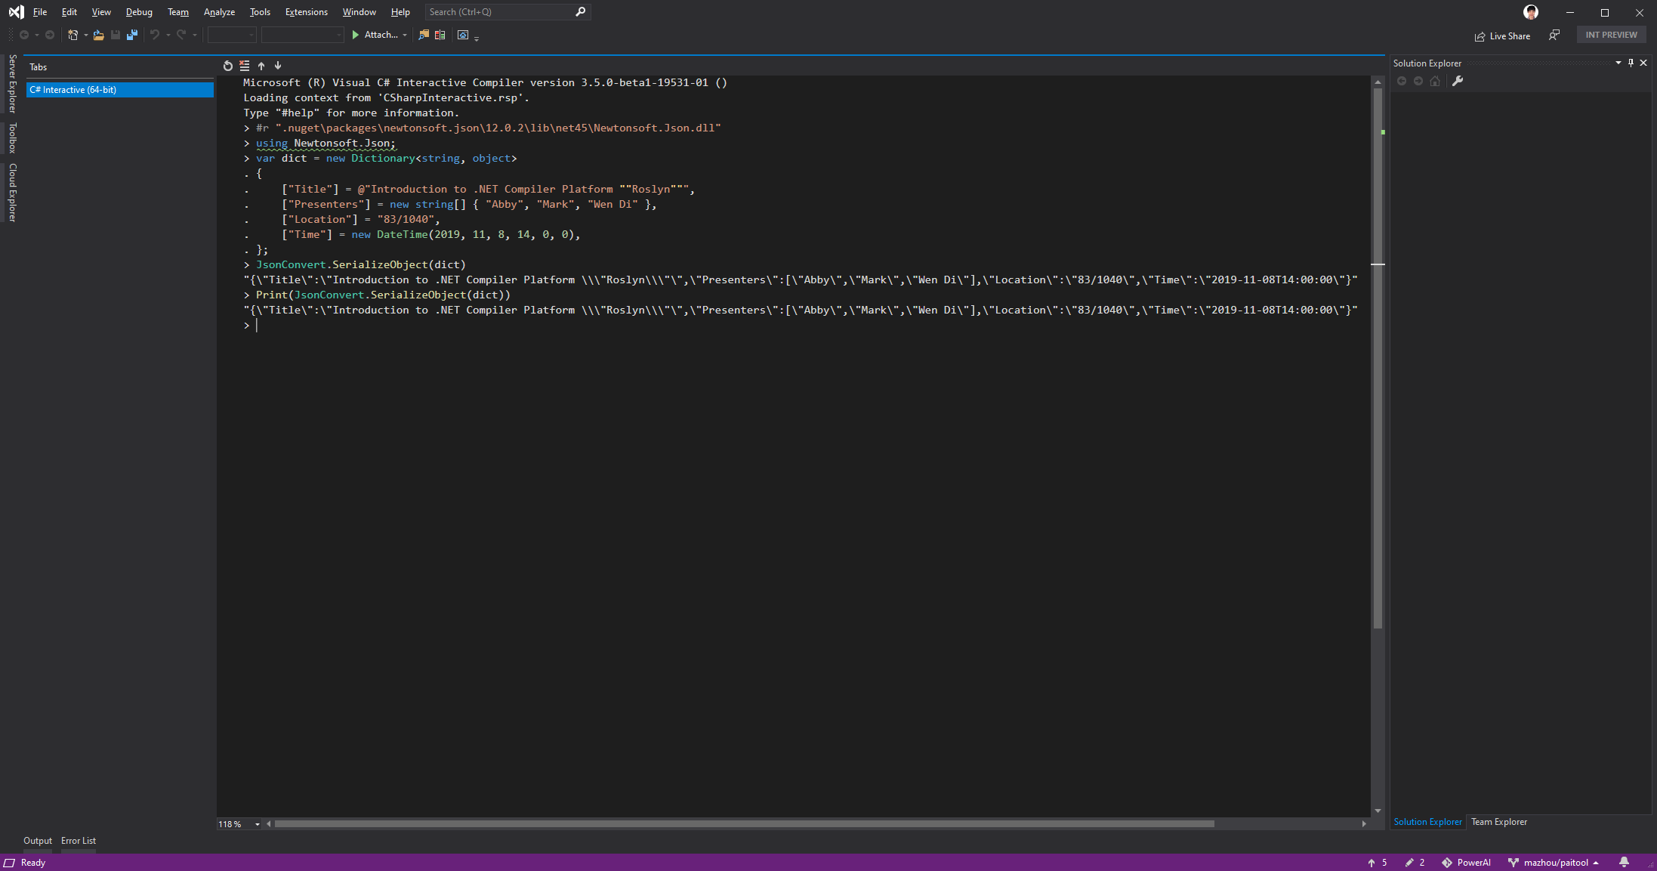

Slide 20
Useful Resources
http://referencesource.microsoft.com
http://source.roslyn.io
https://sharplab.io
https://github.com/dotnet/roslyn
https://online.visualstudio.com
Notes:
At indexing time, C# and VB source code is analyzed using Roslyn and a lot of static hyperlinked HTML files are generated into the output directory. There is no database. The website is mostly static HTML where all the links, source code coloring etc. are precalculated at indexing time. All the hyperlinks are hardwired to be simple links bypassing the server.
The only component that runs on the webserver is a service that given a search query does the lookup and returns a list of matching types and members, which are hyperlinks into the static HTML. The webservice keeps a list of all declared types and members in memory, this list is also precalculated at indexing time. All services, such as Find All References, Project Explorer, etc. are all pre-rendered.

